Slide 1
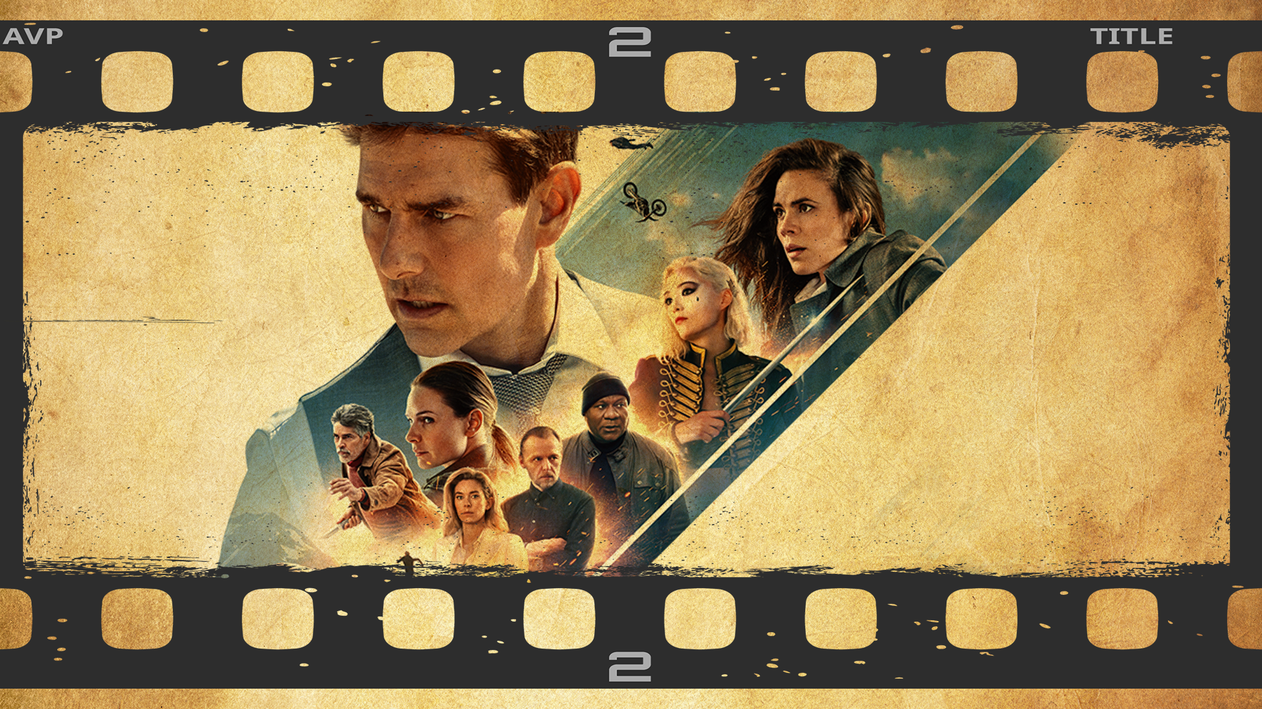
Permission Impossible
Dead Reckoning Pain

Slide 2




Slide 3
Acknowledgements

Slide 4
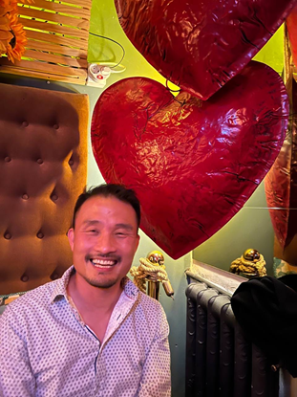
Shameless Self-Plug
Francis Chung
Co-Organiser of Alt.Net and DDD-AU Meetups
30 years in the industry
My first computer was an Apple II
Currently

Slide 5
Once upon a time ….

Slide 6


Slide 7
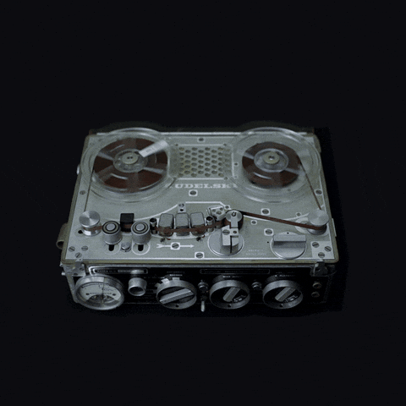
An Impossible Mission was given

Slide 8
Introduce a new User Class The FIRM Accountant

Slide 9

Not this Accountant
with the firm grip

Slide 10
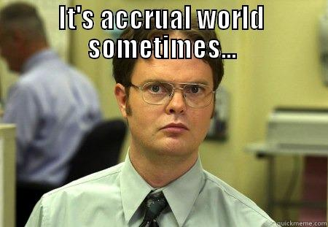
More like this guy with the undeniably Firm Accountant looks … the world is indeed accrual sometimes

Slide 11
Analysis
933 different code changes spanning across 6 systems

Slide 12
Analysis
933 different code changes spanning across 6 systems
Given 1 intern Developer as a resource

Slide 13
Analysis
933 different code changes spanning across 6 systems
Given 1 intern Developer as a resource
I wasn’t allowed to code

Slide 14
Analysis
933 different code changes spanning across 6 systems
Given 1 intern Developer as a resource
I wasn’t allowed to code
I had 2 months to deliver

Slide 15
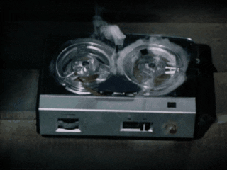
Your project / sanity will self destruct in ….

Slide 16
Permission Impossible
Dead Reckoning Pain

Slide 17
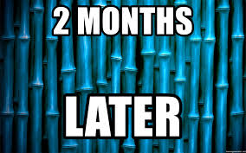
Roughly Speaking …

Slide 18
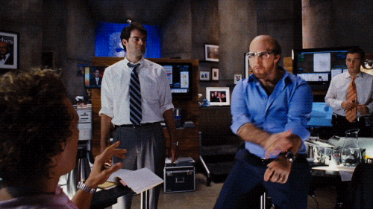
Project Delivered!

Slide 19
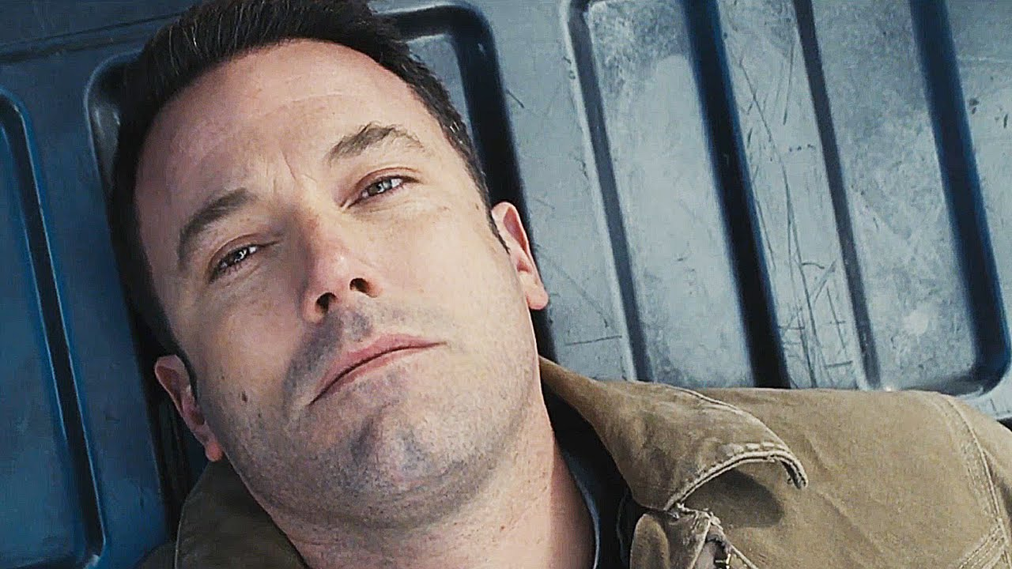
On Reflection …

Slide 20
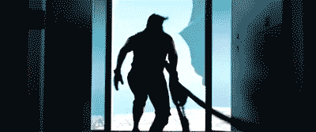
What I should have done

Slide 21
There has to be a better way !

Slide 22
THE END - Part 1

Slide 23
Part 2 - Deeper Dive

Slide 24

Agenda

Slide 25
Authentication vs Authorization

Slide 26
Authentication -
Are you who you say you are?
Notes:
UK Football fans are very authentic and into authentication - “Who are ya, Who are ya”

Slide 27
Authorization - As user X =>
What are you allowed to do? What AREN’T you allowed to do?
Notes:
If you’re in a relationship, you’re constantly asking for Authorization from your greater half

Slide 28
Authentication vs Authorization
Notes:
Otherwise this talk would be finished as everyone knows who I am by now (hopefully?)

Slide 29
Typical Code for checking permissions
def put(self, business_uuid):
if not self.permission.can_update():
raise ForbiddenError
# ... do some updates ...
class <BusinessSetting>Permission(BasePermission):
def can_read(self):
return self.role in [
self.BUSINESS_OWNER_ROLE,
self.BUSINESS_PARTNER_ROLE,
self.ACCOUNTANT_PARTNER_ROLE,
]
def can_update(self):
return self.role in [
self.BUSINESS_OWNER_ROLE,
self.BUSINESS_PARTNER_ROLE,
self.ACCOUNTANT_PARTNER_ROLE,
]

Slide 30
Typical Code for checking permissions
def put(self, business_uuid):
if not self.permission.can_update():
Raise ForbiddenError
# ... do some updates ...
class <BusinessUnit>Permission(BasePermission):
def can_read(self):
return self.role in [
self.BUSINESS_OWNER_ROLE,
self.BUSINESS_PARTNER_ROLE,
self.ACCOUNTANT_PARTNER_ROLE,
]
def can_update(self):
return self.role in [
self.BUSINESS_OWNER_ROLE,
self.BUSINESS_PARTNER_ROLE,
self.ACCOUNTANT_PARTNER_ROLE,
]
Role Based Security
Role based Access Control
(RBAC)
Notes:
Imagine changing / analysing 933 instances of code like this throughout your entire SAAS application

Slide 31
Pros & Cons with RBAC (Role based)
Pros
Simple
Easy to implement
Great for small/medium apps
Well defined Permission Set that doesn’t change

Slide 32
Pros & Cons with RBAC (Role based)
Pros
Simple
Easy to implement
Great for small/medium apps
Well defined Permission Set that doesn’t change
Cons
Not Scalable for Enterprise / SAAS
Difficult to change or introduce new permissions
Simple, Low Granular Permissions
Tight Coupling

Slide 33
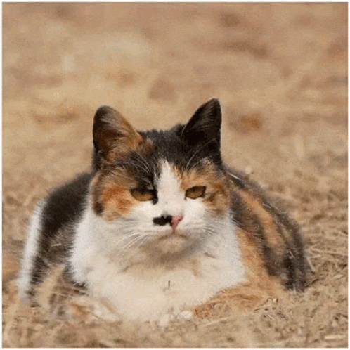
Are there Alternatives out there?
Notes:
Just filled my Cat meme Quota. Check

Slide 34
Attribute Based Access Control (ABAC)
In a Nutshell : -
Method of doing Access Control over attributes across 4 areas
Subject (User)
Resource
Action
Environment

Slide 35
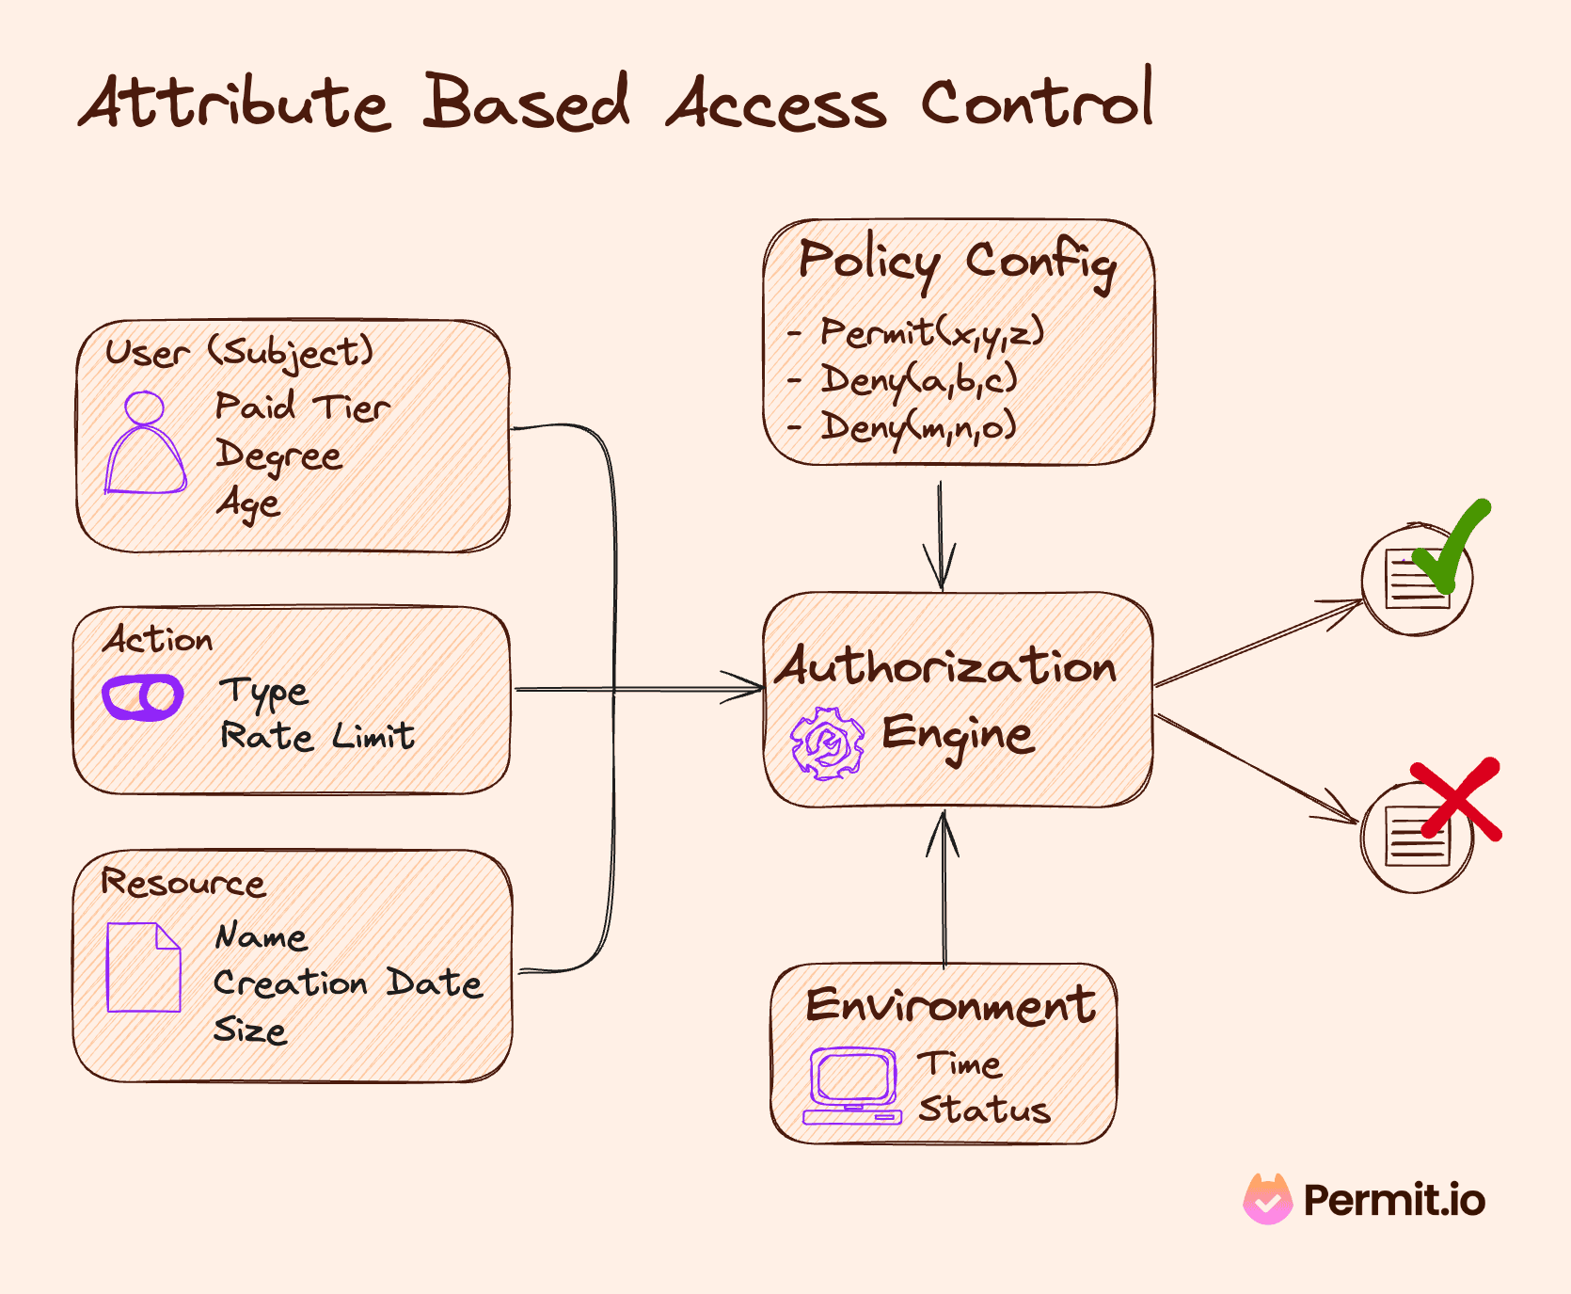

Slide 36
Attribute Based Access Control (ABAC)
Pros
Granular / Flexible Permissions
Easy to implement
Scalable
Better Security + Compliance

Slide 37
Attribute Based Access Control (ABAC)
Pros
Granular / Flexible Permissions
Easy to implement
Scalable
Better Security + Compliance
Cons
Complex!
Performance - Latency
XACML - Extensible Access Control Markup Language

Slide 38
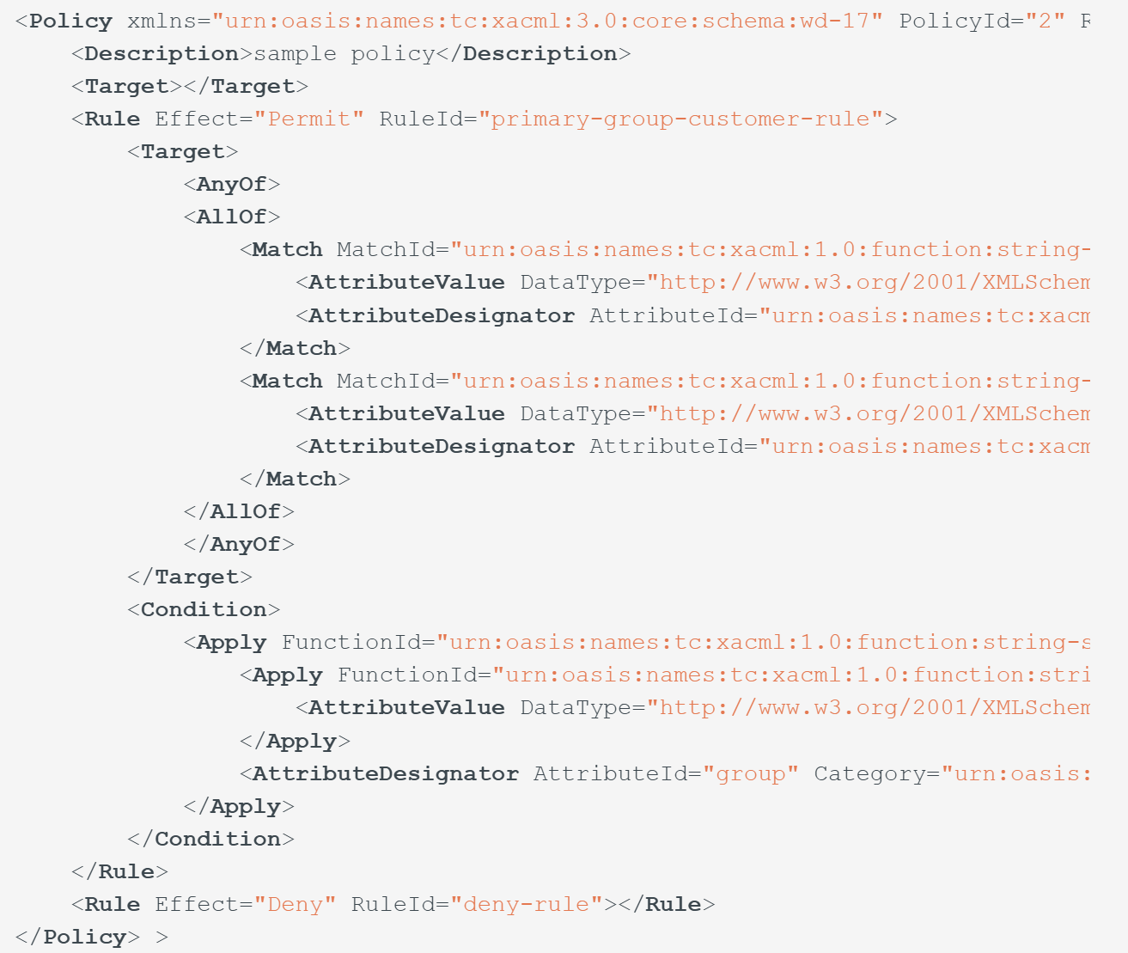
ABAC - XACML Example

Slide 39
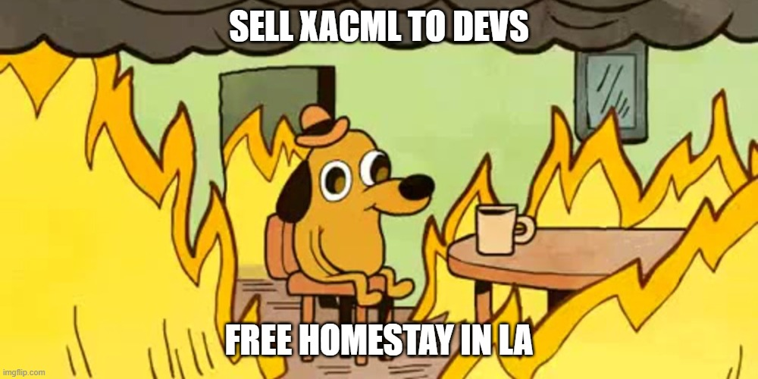

Slide 40
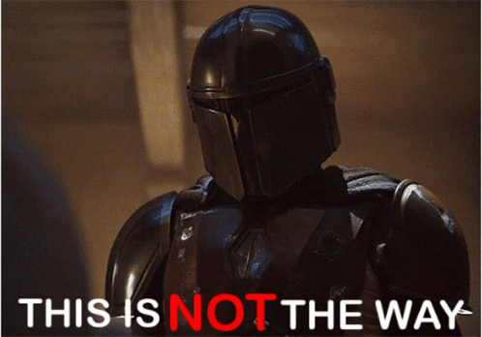
Notes:
Just filled my Cat meme Quota. Check

Slide 41
Google Zanzibar

Slide 42
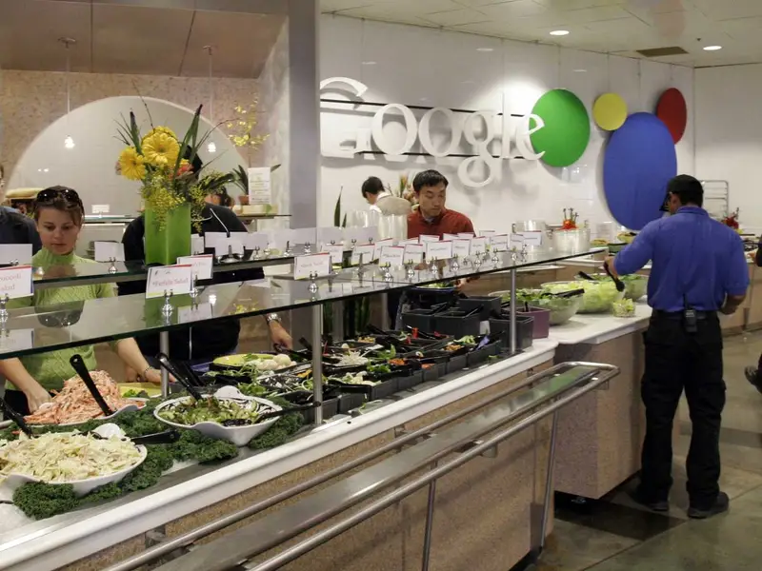
Google Zanzibar
Notes:
Zanzibar is not their famous salad bar in their staff restaurants

Slide 43
Google Zanzibar
Access Control for all of Google’s Services
Calendar, Cloud, Drive, Maps, Photos, and YouTube etc
95th-percentile latency of less than 10 milliseconds
Availability of 99.999% over 3 years
Notes:
50ms is considered a good time for an Authorisation call. In FBs, we had to increase our DataDog latency budget from 250ms to 600ms.

Slide 44
Google Zanzibar
Access Control Server for all of Google’s Services
Calendar, Cloud, Drive, Maps, Photos, and YouTube etc
95th-percentile latency of less than 10 milliseconds
Availability of 99.999% over 3 years
2 trillion relation tuples that occupy close to 100 terabytes
> 10 million client queries per second (QPS)
10,000 servers organized in several dozen clusters
Planetscale Numbers!
Notes:
50ms is considered a good time for an Authorisation call. In FBs, we had to increase our DataDog latency budget from 250ms to 600ms.

Slide 45
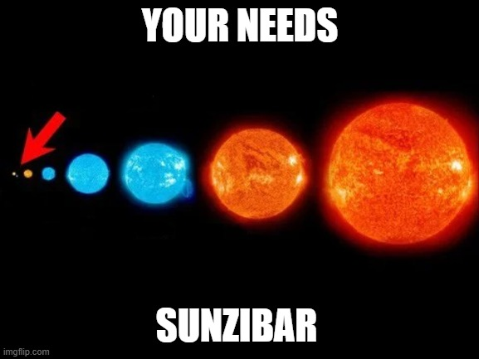
Notes:
Should be very wary when someone mentions PlanetScale, because this is what it usually means

Slide 46
Pros & Cons with RBAC (Role based)
Pros
Simple
Easy to implement
Great for small/medium apps
Well defined Permission Set that doesn’t change
Cons
Not Scalable for Enterprise / SAAS
Difficult to change or introduce new permissions
Simple, Low Granular Permissions
Tight Coupling

Slide 47
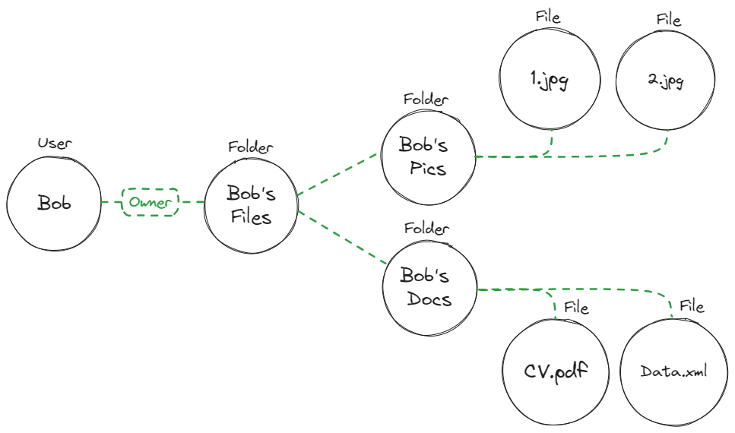

Relationship Based Access Control (ReBAC)

Slide 48
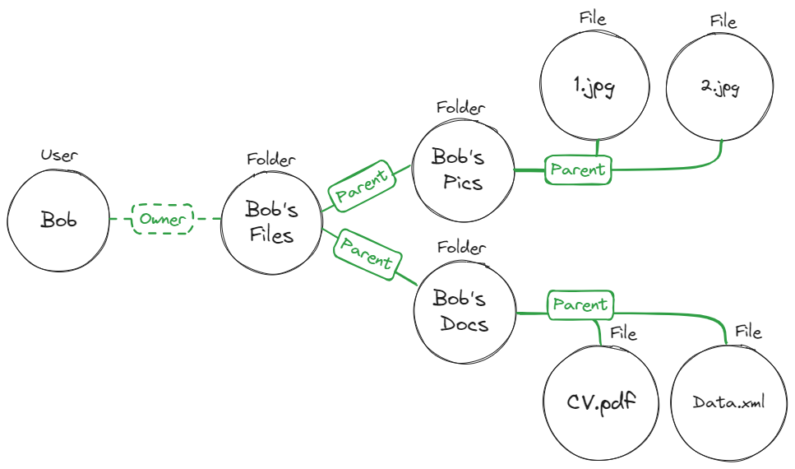
Relationship Based Access Control (ReBAC)

Slide 49
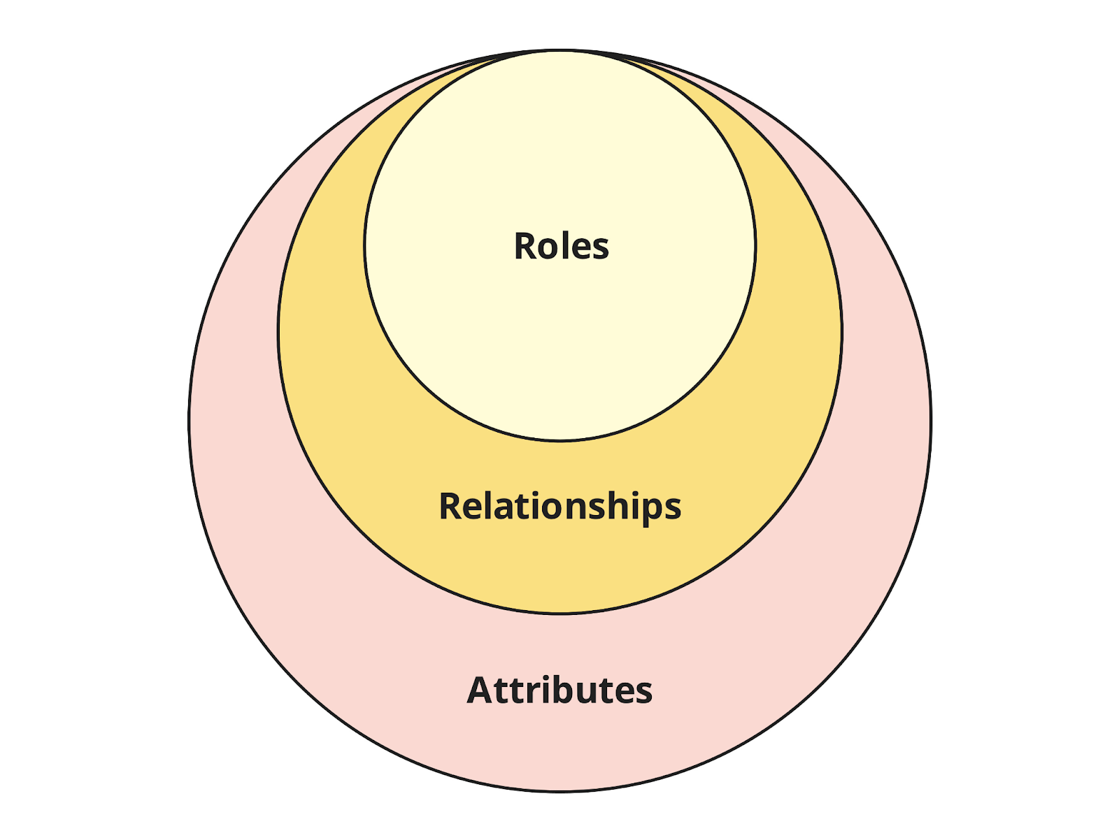

RBAC vs ReBAC vs ABAC - Concepts

Slide 50
Google Zanzibar Solutions
Open Source
SpiceDB
OpenFGA
Ory / Keto
Permify
Permit.io
Commercial
Oso
Auth0 / Okta (OpenFGA)
Notes:
50ms is considered a good time for an Authorisation call. In FBs, we had to increase our DataDog latency budget from 250ms to 600ms.

Slide 51
Relationship Based Access Control (ReBAC)

Slide 52
Relationship Based Access Control (ReBAC)

Slide 54
References
https://www.permit.io/blog/what-is-abac
https://www.permit.io/blog/what-is-rebac
https://permify.co/post/relationship-based-access-control-rebac/
https://www.osohq.com/academy/relationship-based-access-control-rebac
https://www.descope.com/learn/post/rebac
https://zanzibar.tech/2Dy8fNih7E:m:1Y
https://authzed.com/blog/what-is-google-zanzibar

Slide 64
Analysis
933 different code changes spanning across 6 systems

Slide 67
Analysis

Slide 68
Analysis

Slide 69
Analysis

Slide 80
There has to be a Better Way !

Slide 81
MOVIE DESCRIPTION
Mission: Impossible is a thrilling action movie franchise following IMF agent Ethan Hunt and his team as they undertake high-stakes missions to protect the world from dangerous threats. With breathtaking stunts and intense plots, the series showcases Hunt's unwavering determination and teamwork against formidable adversaries. This iconic franchise continues to deliver high-octane entertainment and captivate audiences worldwide.

Slide 82
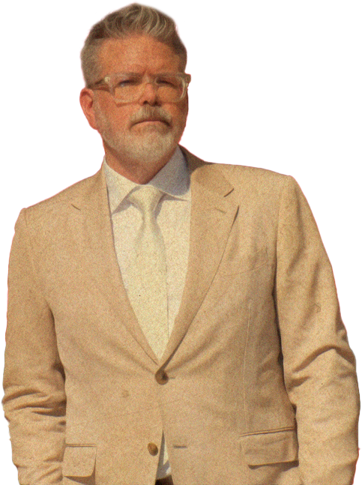
Director
Christopher McQuarrie
Christopher McQuarrie is an accomplished American filmmaker known for his work as a director, screenwriter and producer. He has had a significant impact on the Mission: Impossible movie franchise, particularly in his role as a director. Here are some key points about Christopher McQuarrie's contributions:

Slide 83
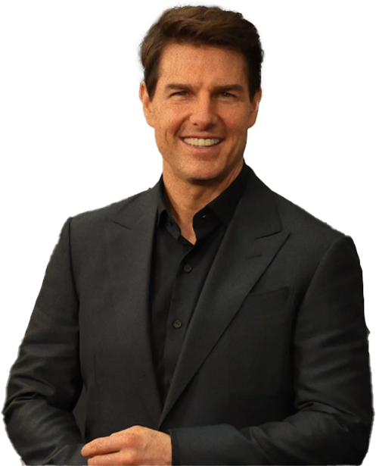
Director
Christopher McQuarrie
Ethan Hunt
Tom Cruise
Ethan Hunt the charismatic and skilled IMF agent, known for his unwavering determination, resourcefulness, and willingness to go to extreme lengths to complete his missions. Throughout the franchise, Ethan's character evolves, facing personal and professional challenges that shape his identity as a dedicated agent.

Slide 84
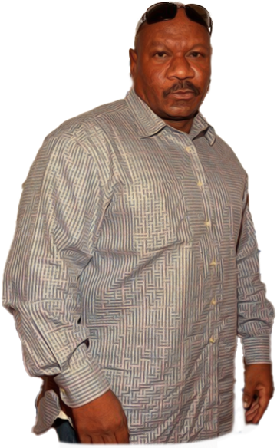
Director
Christopher McQuarrie
Luther Stickell the loyal technical expert and long-time friend of Ethan Hunt. Luther provides crucial support to the IMF team with his hacking and technical skills. He serves as a dependable ally and a valuable member of the team.
Ving Rhames
Luther Stickell

Slide 85
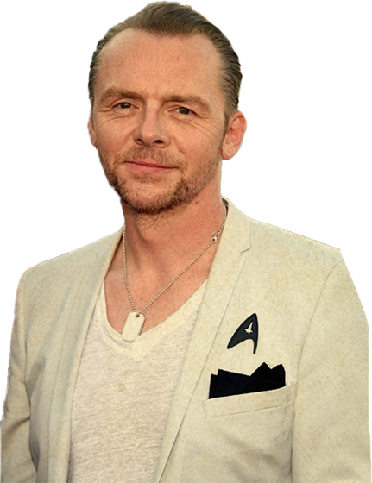
Benji Dunn
Simon Pegg
Benji Dunn The comic relief and tech-savvy member of the IMF. Benji adds levity to intense situations with his witty humour and brings essential technical expertise to the team. His unique personality complements the group dynamic.

Slide 86
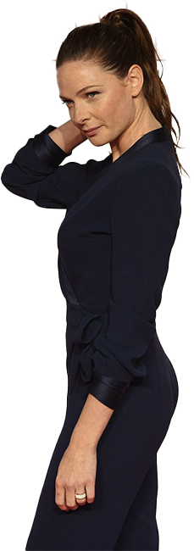
Ilsa Faust an enigmatic and complex character, Ilsa Faust alternates between ally and adversary to Ethan Hunt. Her intriguing background and motivations add depth to the storyline, making her an essential part of the franchise.
Ilsa Faust
Rebecca Ferguson

Slide 87
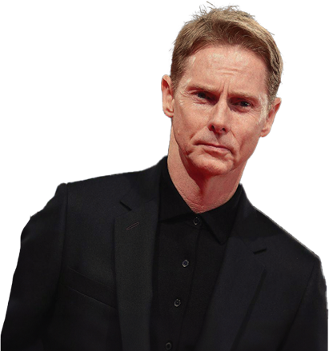
Solomon Lane
Sean Harris
Solomon Lane The cunning and menacing antagonist, responsible for challenging the IMF team and Ethan Hunt in particular. Lane's role as a formidable foe adds tension and suspense to the movies.

Slide 88
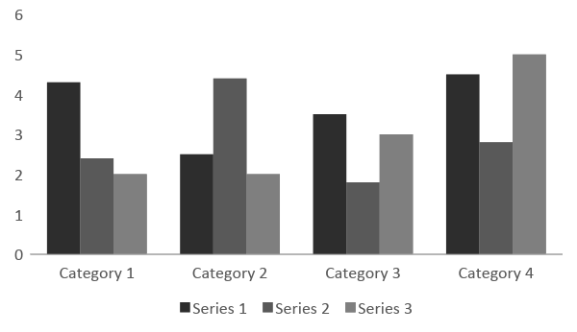
CRITICAL AND COMMERCIAL SUCCESS

Slide 89
Mission: Impossible - Rogue Nation
Mission: Impossible - Fallout
Mission: Impossible – Dead Reckoning Part One
2018
2015
2023
$682,716,636
$791,657,398
$370,853,469

Slide 90
MUSIC DERECTORS
Mission: Impossible - Rogue Nation (2015)
Composed by Joe Kraemer
Mission: Impossible - Fallout (2018)
Composed by Lorne Balfe
Mission: Impossible - Fallout (2018)
Composed by Lorne Balfe

Slide 91
Mission: Impossible - Rogue Nation (2015):
Nominated for a BAFTA Award for Best Special Visual Effects.
Mission: Impossible - Fallout (2018):
Nominated for two Academy Awards in the categories of Best Film Editing and Best Sound Editing.
Critics' Choice Movie Awards:
Mission: Impossible - Fallout won the Critics' Choice Movie Award for Best Action Movie in 2019.
Saturn Awards:
Various Mission: Impossible movies have received nominations and awards from the Academy of Science Fiction, Fantasy & Horror Films.
AWARDS

Slide 92


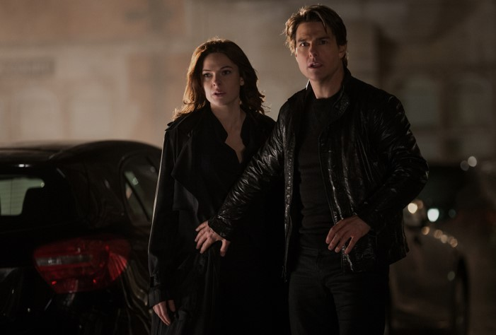
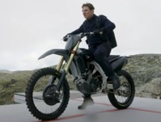

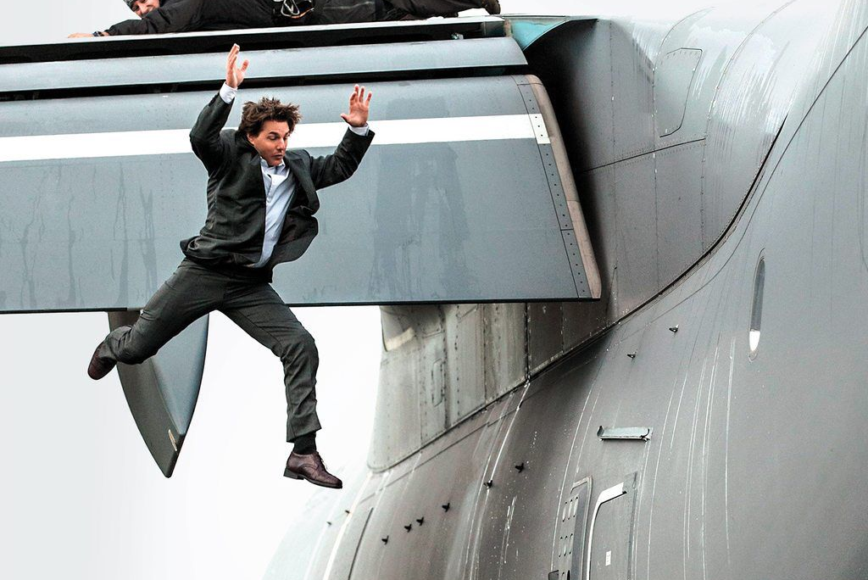

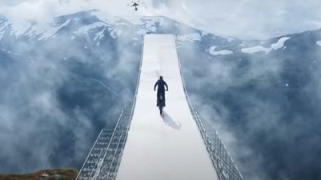
BEHIND THE SCENES

Slide 93
CONCLUSION
The enduring success of the Mission: Impossible franchise is truly remarkable. Spanning decades, it consistently delivers thrilling action, captivating characters and mind-bending plots. With each instalment, it sets new standards for action filmmaking, leaving an indelible mark on popular culture. We admire the creativity, passion and dedication that keep Mission: Impossible a global cinematic phenomenon. Here's to its ongoing inspiration and entertainment for audiences worldwide.

Slide 94
You must credit Slidechef in order to use this template
What you are allowed to do :
Modify this template
Use it for personal or commercial projects
What you are not allowed to do :
Offer Slidechef templates for download
Sublicense, sell or rent any Slidechef content
Distribute Slidechef content unless it has been authorized
Include Slidechef content in an online or offline file
Acquire the copyright of Slidechef content
INSTRUCTIONS
FOR USE

